Slide 1
First Power Point Presentation
Mishal Shehzadi

Slide 2
Family Members
Muhammad Fayyaz
Tasleem Akhter
Aown Abbas
Kanwal Shehzadi
Mishal Shehzadi

Slide 3
Fruit Names
Apple
Orange
Banana
Pomegranate
Grapes

Slide 4

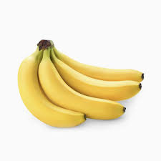
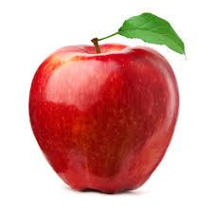
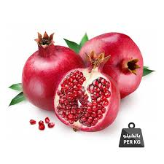
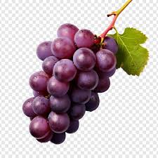
Pictures
Apple
Orange
Banana
Pomegranate
Grapes

